Slide 1
Homework 1
Simple code generator
Aristeidis Mastoras
Compiler Design – SS18
(based on slides of Luca Della Toffola from Compiler Design – HS15)

Slide 2
Administrative issues
Has everyone found a teammate?
Mailing-list: cd1@lists.inf.ethz.ch
  Please subscribe if we forgot you
Assistants: cd1-owner@lists.inf.ethz.ch

Slide 3
Today
HW Overview
SVN
Javali
HW1

Slide 4
Today
HW Overview
SVN
Javali
HW1

Slide 5
This course
Build a full Javali compiler
Lexical Analysis
Syntax
Analysis
Semantic
Analysis
Code
Generation

Slide 6
This course
HW2
Lexical Analysis
Syntax
Analysis
Semantic
Analysis
Code
Generation
Parser

Slide 7
This course
HW3
Lexical Analysis
Syntax
Analysis
Semantic
Analysis
Code
Generation

Slide 8
This course
HW4
Lexical Analysis
Syntax
Analysis
Semantic
Analysis
Code
Generation

Slide 9
This course
Global optimizations
or
Javali advanced features
HW6
Lexical Analysis
Syntax
Analysis
Semantic
Analysis
Code
Generation

Slide 10
Homework 1
Lexical Analysis
Syntax
Analysis
Semantic
Analysis
Code
Generation

Slide 11
Homework 1
Variable declarations
Assignments
Simple expressions
Lexical Analysis
Syntax
Analysis
Semantic
Analysis
Code
Generation

Slide 12
Homework 1
Variable declarations
Assignments
Simple expressions
Lexical Analysis
Syntax
Analysis
Semantic
Analysis
Code
Generation
We give you the parser

Slide 13
Homework 1
Variable declarations
Assignments
Simple expressions
Lexical Analysis
Syntax
Analysis
Semantic
Analysis
Code
Generation
Not necessary for now

Slide 14
Grading
Homework task
  The compiler “works”
Write your own tests
  Test exhaustively that the compiler works
Code quality
  The code is readable

Slide 15
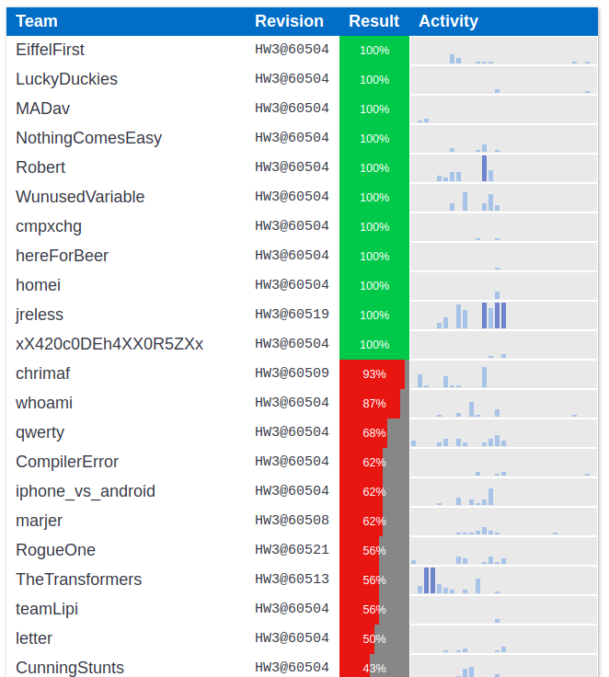
Grading
Indication of your grade
Link will be announced

Slide 16
Good news!
HW1 is independent of HW2
The same applies to the next HW
You can still do the next HW even if you don’t manage to get this right

Slide 17
Today
HW Overview
SVN
Javali
HW1

Slide 18
SVN
What is SVN?
a version control system
it is used to store current and previous versions of (not only) source code
you can revert to a previous version

Slide 19
Javali fragment
We provide:
a compiler skeleton for every HW
stored in an SVN repository
every team has a different SVN repository

Slide 20
Get your fragment
https://svn.inf.ethz.ch/svn/trg/cd_students/ss18/teams/<YourTeam>
Case-sensitive
Homework + grades
Your submission platform

Slide 21
SVN basics
svn checkout https://<your_SVN_repo>
Get the remote copy of the repository on your machine.
svn commit –m “Message about your changes”
Update remote copy of the repository with local changes.
svn update
Get remote changes of your repository if modified.

Slide 22
SVN basics
svn add <file-or-dir-name>
Add a file/directory to the local copy.
(It requires commit to update the remote copy.)
svn remove <file-or-dir-name>
Delete a file/directory from the local copy.
(It requires commit to update the remote copy.)

Slide 23
SVN basics
svn status
Report files that are different in the local copy from those in the remote copy.
svn diff –r <version-number> <file-name>
Report the differences between the local copy and a specific version.

Slide 24
SVN resources
Links
  http://svnbook.red-bean.com
  https://www.google.ch/search?q=svn+tutorial
Software
  Eclipse Subversive
  Tortoise SVN
  Command-line

Slide 25
Today
HW Overview
SVN
Javali
HW1

Slide 26
Javali
Simple OO programming language
  Subset of Java
Javali specification in the course web-site
  Updated recently, subject to changes (and bugs)
When the specification is incomplete
  Common sense or Java specification apply
  Use the mailing-list for clarifications or questions

Slide 27
Javali framework
We provide a framework skeleton
  To use for your homework
  Utility classes and basic tasks
  Free to modify or create your own
  Please comply to submission requirements
After each homework we provide a solution

Slide 28
Javali framework
src
Source of the compiler
test
Source files for testing your compiler
lib
Compiler dependencies as .JAR files
javali_tests
Unit-tests in form of .javali files. These are example programs to test
build.xml
Optional ANT script for command-line (can be used in Eclipse)

Slide 29
Compile the Javali framework
Fragment is an Eclipse project, it will build automatically
If you don’t use Eclipse, install ANT and type:
ant test
It compiles automatically too ☺

Slide 30
How to test your Javali compiler
We provide a JUnit-based testing framework
A test is a Javali program in the javali_tests directory
The testing framework compares the output of your compiler against our reference solution
To test your compiler write more Javali programs that cover assignment tasks
You need to see green

Slide 31
How to test your Javali compiler
Expected results are stored in .javali.exec.ref files
.javali.in file determines the standard input
  One line is equivalent to the result of a read() call.
Run the tests using JUnit4
  Eclipse provides a GUI to inspect results
.javali.err file contains debugging output and error messages

Slide 32
DEMO

Slide 33
Javali framework changes
Files that may change per fragment
lib/frozenReference.jar @ every fragment
build.xml depending on the assignment
  We will provide details in the recitation
  Look for new targets
Javali specification
  As previously mentioned

Slide 34
Today
HW Overview
SVN
Javali
HW1

Slide 35
Simple code generator
Input: Javali Program
Output: x86 Assembly
.section .data
STR_D:
.string "%d"
.section .data
var_a:
.int 0
.section .text
.globl main
main:
…
class Main {
void main() {
int a;
a = 10;
write(a);
}
}

Slide 36
Simple code generator
main:
…
# Emitting a = 10
# Emitting 10
movl $10, %edi
movl %edi, var_a
# Emitting write(a)
# Emitting a
movl var_a, %edi
sub $16, %esp
movl %edi, 4(%esp)
movl $STR_D, 0(%esp)
call printf
add $16, %esp
…
?
class Main {
void main() {
int a;
a = 10;
write(a);
}
}

Slide 37
Javali program representation
The Intermediate Representation of Javali compiler is an Abstract Syntax Tree
ClassDecl
MethodDecl
class Main {
void main() {
int a;
a = 10;
write(a);
}
}
Seq
Seq
VarDecl
Assign
BuiltInWrite
Var
IntConst
Var
We give you the IR, i.e., the AST.
You need to generate the assembly code by using the AST.

Slide 38
Another example
Input: Javali Program Output: x86 Assembly
main:
...
# Emitting a = 10
# Emitting 10
movl $10, %edi
movl %edi, var_a
# Emitting b = (a + 7)
# Emitting (a + 7)
# Emitting 7
movl $7, %edi
# Emitting a
movl var_a, %esi
add %edi, %esi
movl %esi, var_b
...
class Main {
void main() {
int a, b;
a = 10;
b = a + 7;
}
}
=
b
+
a
7

Slide 39
Javali Abstract Syntax Tree
abstract classes
Ast
Decl
Stmt
Expr
…
…
…
concrete classes for nodes used from the IR
Ast nodes declared in cd/ir/Ast.java

Slide 40
Javali Abstract Syntax Tree
Declarations
ClassDecl, MethodDecl, VarDecl
Statements
Assign, BuiltInWrite, BuiltInWriteln, IfElse, MethodCall, WhileLoop, Nop
Expressions
Var, IntConst, UnaryOp, BinaryOp, BuiltInRead, Index, NewArray, Field, Cast, NullConst, ThisRef, NewObject, BooleanConst

Slide 41
Javali Abstract Syntax Tree
Declarations
ClassDecl, MethodDecl, VarDecl
Statements
Assign, BuiltInWrite, BuiltInWriteln, IfElse, MethodCall, WhileLoop, Nop
Expressions
Var, IntConst, UnaryOp, BinaryOp, BuiltInRead, Index, NewArray, Field, Cast, NullConst, ThisRef, NewObject, BooleanConst
Only a subset of the AST nodes are used in Homework 1

Slide 42
Print the Abstract Syntax Tree
We provide a utility class to print the AST
  cd/util/debug/AstDump.java
To check the AST for a test program
  Examine the .parser.ref file, or the .err file.
All AST nodes also have a toString() method

Slide 43
DEMO

Slide 44
Traverse the Abstract Syntax Tree
How can we traverse the AST?
Similarly to a (binary) tree.

Slide 45
Traverse a binary tree
How can we traverse a binary tree?
1
public class Visitor {
void visit(TreeNode node) {
if (node.leftchild != null)
visit(node.leftchild);
if (node.rightchild != null)
visit(node.rightchild);
}
}
2
5
3
4
6
7

Slide 46
Traverse a binary tree
What if different nodes have different colors and different behavior?
Blue nodes: print “blue”
Green nodes: print “green”

Slide 47
Traverse a binary tree
abstract class TreeNode {
public TreeNode leftchild;
public TreeNode rightchild;
…
}
class BlueNode extends TreeNode { … }
class GreenNode extends TreeNode { … }

Slide 48
Traverse a binary tree
public class Visitor {
void visit(TreeNode node) {
if (node instanceof BlueNode)
print “blue”;
else if (node instanceof GreenNode)
print “green”;
if (node.leftchild != null) visit(node.leftchild);
if (node.rightchild != null) visit(node.rightchild); }
}
Add node-specific behavior

Slide 49
Traverse a binary tree
This simple solution works well.
But, there are more elegant solutions.
Usage of design patterns.

Slide 50
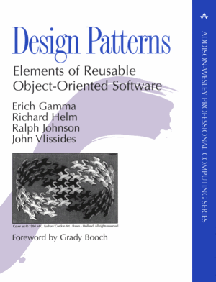
Design patterns
… are descriptions of communicating objects and classes customized to solve a general design problem in a particular context
Gamma et al.
Design Patterns
Elements of Reusable Object-Oriented Software

Slide 51
Design patterns
Wikipedia says:
It is a general reusable solution to a commonly occurring problem within a given context in software design
It is a description or template for how to solve a problem that can be used in many different situations

Slide 52
Design patterns
There are many design patterns
Patterns are related and can be combined
  Design good software is an art
  We may need multiple “tools” to solve a problem
Examples of patterns that can be useful to build your compiler
  (and that you may find in our reference solution)

Slide 53
Design patterns - Visitor
Intent
Defines an operation for an object structure.
Description
Separates an algorithm from an object structure
Does not change the structure
Does not change class interface(s)
Supports distinct unrelated operations

Slide 54
Visitor design pattern solution
class BlueNode extends TreeNode {
void accept(Visitor v) {
v.blueNode(this);
}
}
class GreenNode extends TreeNode {
void accept(Visitor v) {
v.greenNode(this);
}
}
We define a method accept() for each node.
The accept method calls the proper method of the visitor class.

Slide 55
Visitor design pattern solution
public class Visitor {
public void blueNode(BlueNode node) {
print “blue”;
if (node.leftchild != null) node.leftchild.accept(this);
if (node.rightchild != null) node.rightchild.accept(this);
}
public void greenNode(GreenNode node) {
print “green”;
if (node.leftchild != null) node.leftchild.accept(this);
if (node.rightchild != null) node.rightchild.accept(this);
}
}

Slide 56
DEMO

Slide 57
Traverse the Abstract Syntax Tree
Javali framework implements two main visitors to traverse the AST:
  ExprVisitor<R,A> for Expressions
  AstVisitor<R,A> for Statements and Declarations
Apply an operation for each AST node
Avoid to modify AST class
Generic parameters
R = result
A = argument

Slide 58
Traverse the Abstract Syntax Tree
Two visitors for the code generator:
ExprGenerator extends ExprVisitor<Register, Void>
StmtGenerator extends AstVisitor<Register, Void>

Slide 59
Traverse the Abstract Syntax Tree
You can implement another Visitor to traverse the AST of an expression:
calculate the required number of registers
e.g., 7 * (a + 1)
*
7
+
a
1

Slide 60
HW1 summary
Implementation of simple code generator
No stack frame necessary
Use .data section slots for each variable
Look for throw new ToDoException()
Use registers for intermediate results
Use optimal number of registers

